Slide 1
Movie Data Analysis & Revenue Prediction
Project Report
Peng Wenxuan, Wan Yaxin, Wang Yiying
Notes:
Dear friends, this is a mini project report which analyzes movie data and predicts its revenue

Slide 2
Table of Contents
03
01
02
04
05
Problem Definition
Data Exploratory Analysis
Outcome & Insights
06
Data Processing
Machine Learning
Improvement
Notes:
And this is our table of contents

Slide 3
01
Problem Definition
Notes:
So first, we will talk about the problem definition,

Slide 4

Problem Definition
To construct a machine-learning model for predicting movie revenues based on various features such as budget and vote counts.
This Photo by Unknown Author is licensed under CC BY-NC
Notes:
As the data is about movie, we would like to predict a factor that is highly related with the success of a movie, the revenue. We want to construct a machine-learning model to predict movie revenues based on several features provided by the data, which is originally from TMDB website and is explored and processed by ourselves.

Slide 5


02
Data Processing
Notes:
After deciding the problem, we start to process the data.

Slide 6
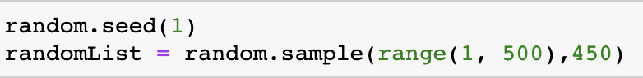
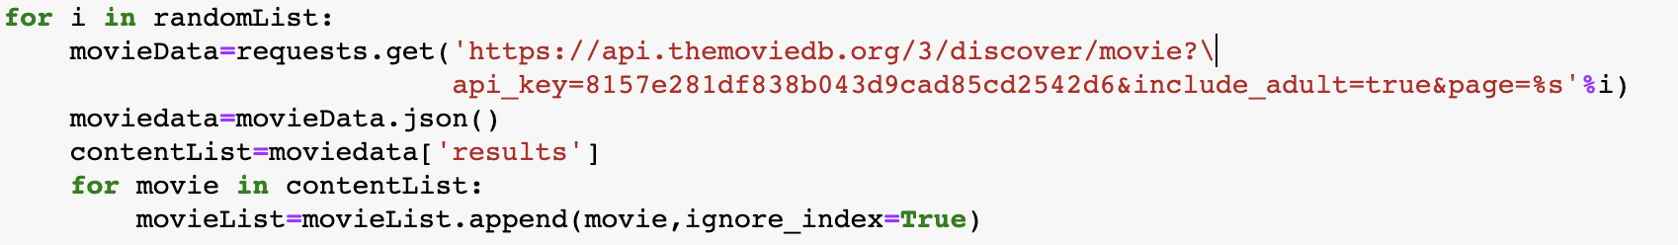
Data Collection
Firstly we extract 9,000 movies from TMDB website by randomly accessing page using API key.
Notes:
First we randomly generate 450 numbers ranged from 1 to 500, we tried value larger than 500 but it seems that there aren’t so many pages. Then we use the “request.get” function, which can extract certain movie data by giving some restrictions, here we request to get data in certain pages by passing the random number as the page number. We also include adult to be true but seems that there are really few adult movies, and I don’t know why. But after investigation, we found that adult is not an important factor deciding movie revenues, so we just throw it away.

Slide 7
Data Selection
Dropping invalid data (e.g., budget value is 0, vote count is 0) and obvious useless data (e.g., id in IMDB).
We get 3,907 movie data and save it as csv file for future usage.
Notes:
After collection, we drop some invalid data such as no record of budget value or vote count. We also drop obvious useless data such as id in IMDB and adult as mentioned.
And we get 3,907 movie data finally, since it run really long each time it extracts data, we save it as csv file for future convenience.

Slide 8
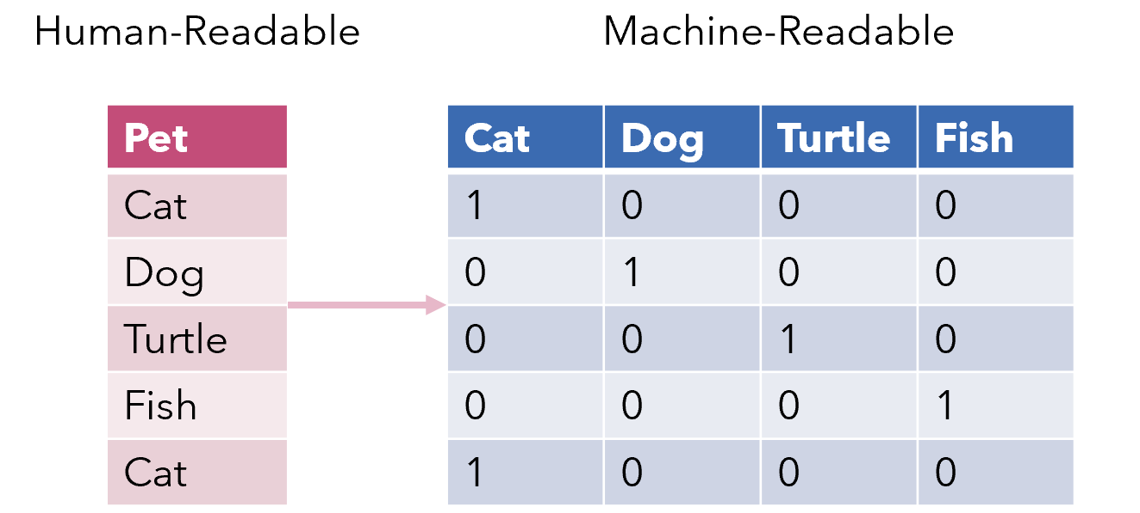
Data Preparation
As one movie may belong to multiple genres or have multiple available languages, we encode these categorical variables by one-hot encoding (convert categorical variables to numerical variables).
Notes:
Then we do some data cleaning.
Here we use one-hot encoding method to convert categorical variables to numerical variables, which is readable by machine.
By doing so, these categorical variables can be considered as possible factors in the prediction model.

Slide 9
Data Preparation
Similarly, we divide release date into weekday, month, season and year for exploration.
weekday
month
season
year
Notes:
We also subdivide release date into weekday, month, season and year and encode these variables by one-hot encoding as mentioned.

Slide 10
03 Exploratory Analysis
Notes:
After preparing data, we start to explore and analyze our dataset.

Slide 11
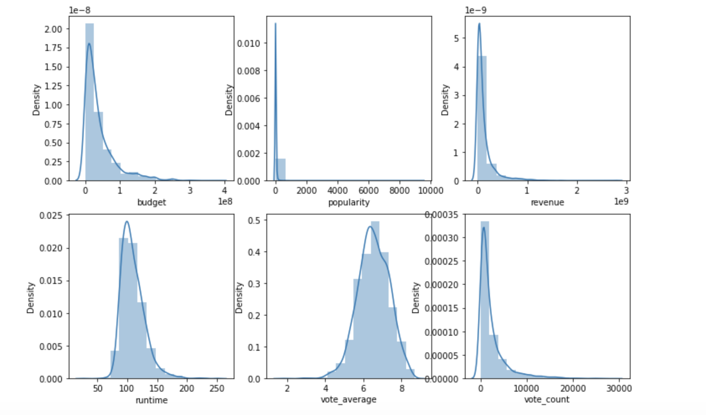
Numeric Data Exploration: Univariate Plot
Runtime and vote_average are close to normal distribution. Others have relatively higher skewness.
Notes:
First we plot uni-numeric data. As u can see, the skewness of top three graphs is high. Runtime and vote-average are close to normal distribution.

Slide 12
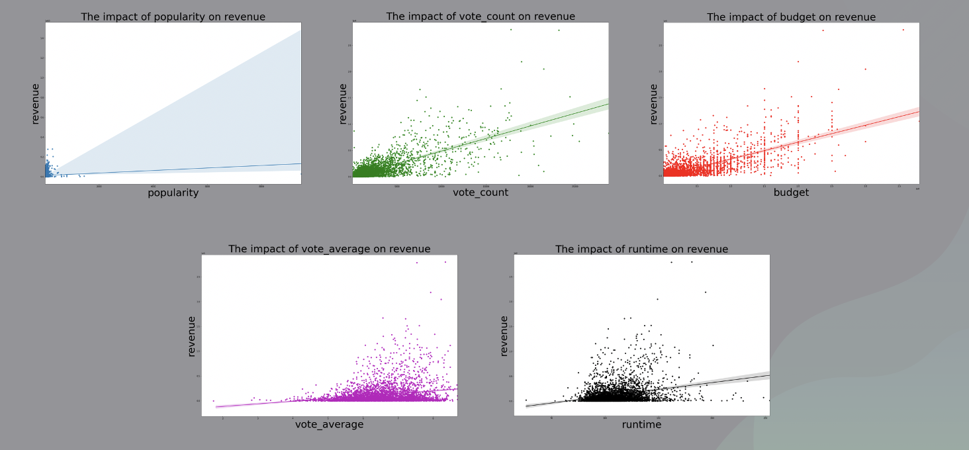
Numeric Data Exploration: Each VS Revenue
Notes:
Then we do bi-plots between each numeric data and revenue,

Slide 13
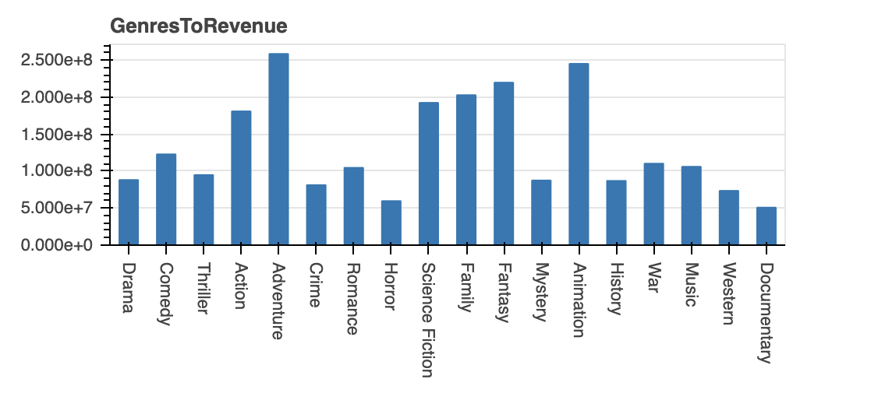
Categorical Data Exploration: Genres VS Revenue
Notes:
Then we do bi-plot between genres and revenue, and we found that adventure, animation and fantasy movie seems to gain more revenue overall.

Slide 14
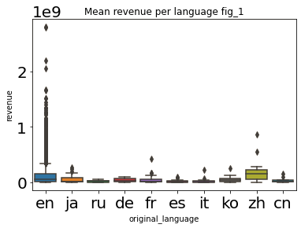
Categorical Data Exploration: Language VS Revenue
Notes:
We also do bi-plot between language and revenue but the graph doesn’t look good since the revenues are too large, thus we log the revenue and it look better now.

Slide 15
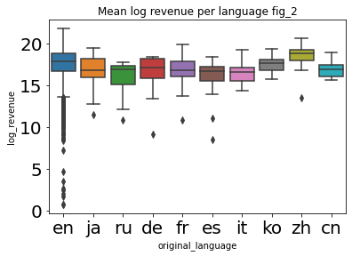
Categorical Data Exploration: Language VS Revenue

Slide 16

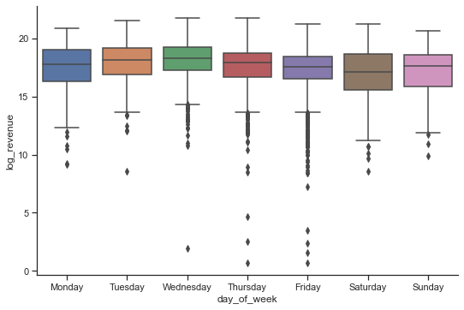
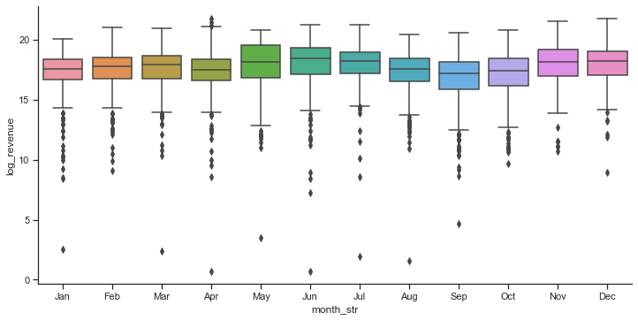
Categorical Data Exploration: Time VS Revenue
Weekday
month
Notes:
And finally, we do bi-plot between time and revenue, we do weekday, month,

Slide 17
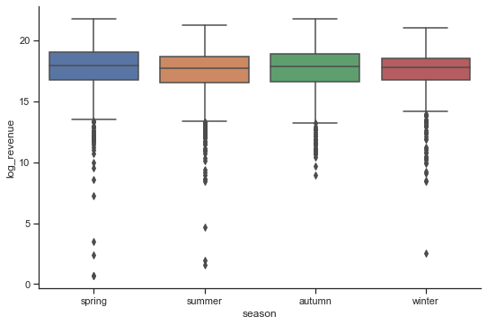
Categorical Data Exploration: Time VS Revenue
Season
Notes:
Season,

Slide 18
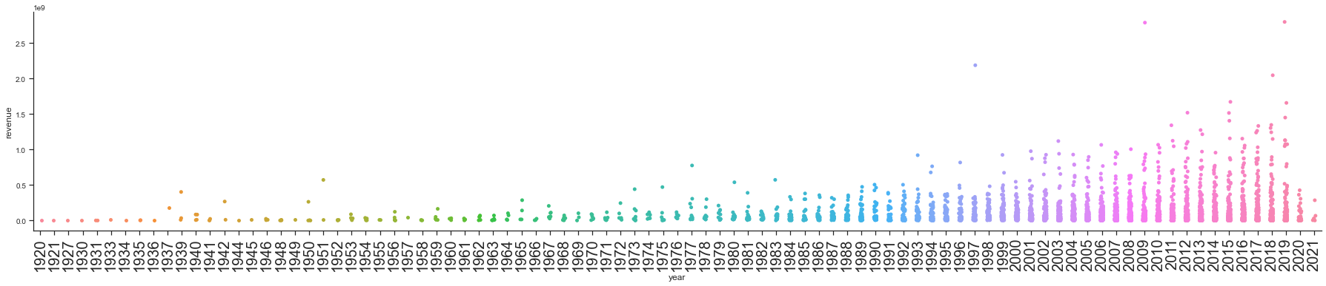
Categorical Data Exploration: Time VS Revenue
Year
Notes:
And year separately and seems that weekday and month relate to revenue more than others.

Slide 19

04 Machine Learning

Slide 20
Objective
Method
Build a model
to predict revenue
Regression
Random Forest Regressor

Slide 21
Objective
Method
Build a model
to predict revenue
Regression
Random Forest Regressor

Slide 22
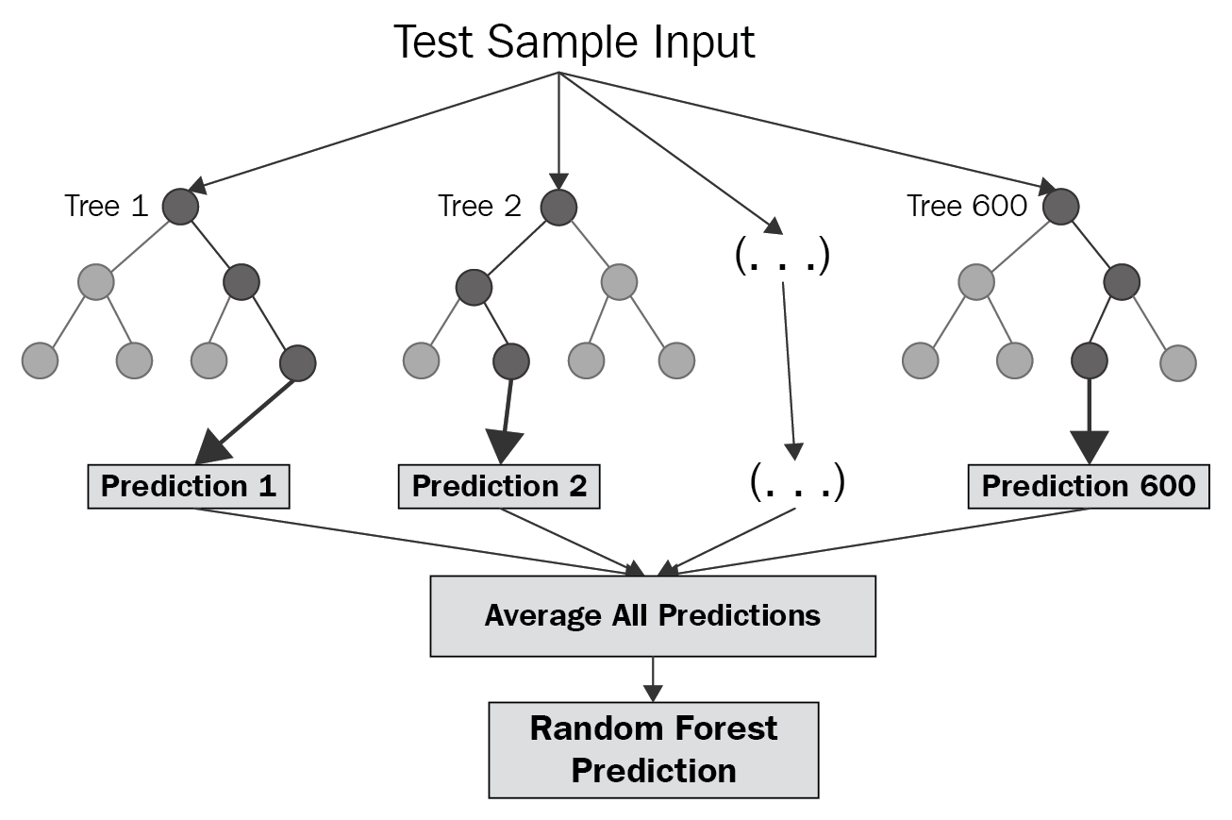
Regression & Random Forest
Random Forest is an ensemble of decision trees, and each tree is created from a different sample of features and rows.
The algorithm averages all predictions to produce a single result. The averaging makes a Random Forest better than a single decision tree and hence it improves accuracy and reduces overfitting.

Slide 23
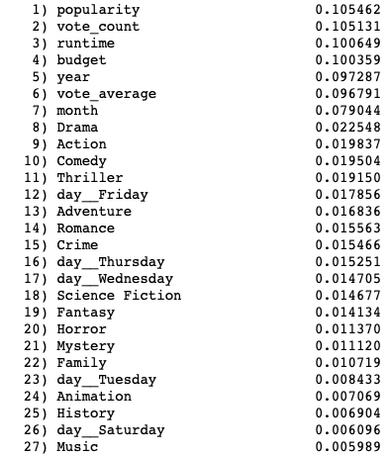
“Best Features”
Problem
Too many predictors
Some predictors have less value for training the model
Random Forest Classifier
From the sorted list we chose first 22 features as the best features.
for prediction, which have an importance value bigger than 0.01.

Slide 24
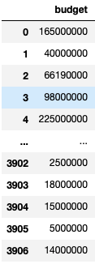
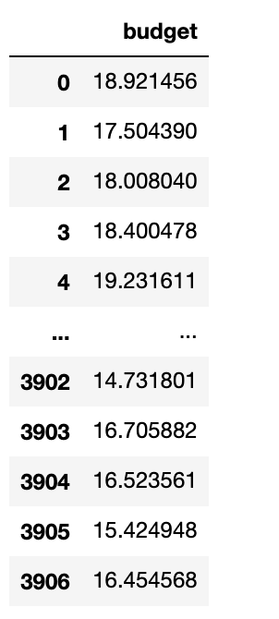
“Best Features”
Problem
Values of variable “budget” too large for training
Solution
Take the natural logarithm of budget values
before
after

Slide 25
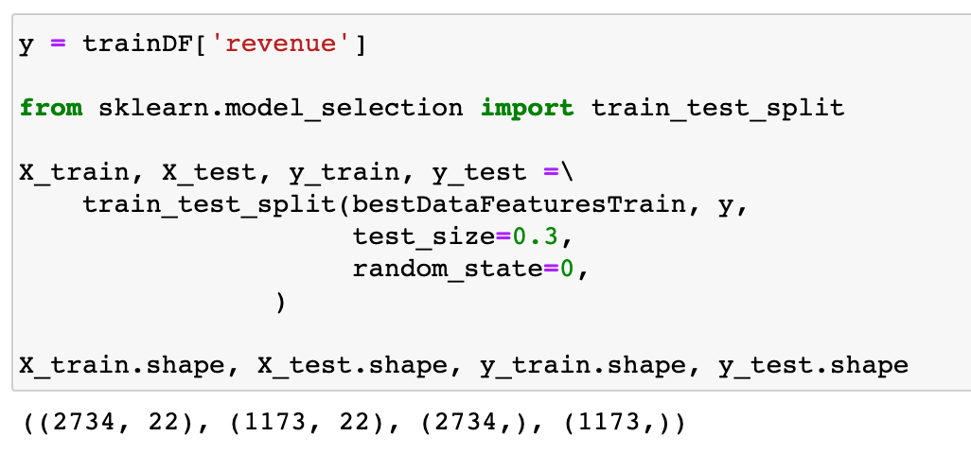
Train the Data
X: Best features
Y: Revenue
Train set: 2734 movies
Test set: 1173 movies
Train Dataset:
Score of model = 0.9545192781070835

Slide 26
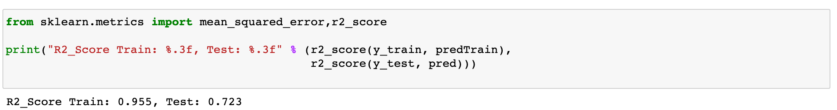
Test the Data
X: Best features
Y: Revenue
Train set: 2734 movies
Test set: 1173 movies
Test Dataset:
Score of model = 0.7227797197127146

Slide 27
05
Outcome & Insights

Slide 28
budget, vote_count, popularity Have high correlations with movie revenue Show greater importance in the prediction model. Movies with more investment and suited to the tastes of public can bring higher profits.

Slide 29
The number of movies in all kinds of genres increases with time, especially drama and comedy Adventure and animation movies tend to have higher average revenue English and Chinese movies generally have higher average revenues

Slide 30
New things we learned…
How to extract useful data from webpages with an API and integrate the information to convert it into a csv file.
How to use one-hot coding to convert multi-categorial variables into many single columns that are much easier to deal with.
How to separate the date information into ‘year’, ‘month’ and ‘weekday’ and draw line charts with time to show the changes.

Slide 31
New things we learned…
Take natural logarithm of some very big data to make it easier for model to predict.
A new machine learning technique, which is random forest regression model to do the prediction

Slide 32

06 Improvement

Slide 33
Room for improvement
Include all data on actors, companies, directors, keywords and so on. This would require higher ability in processing the data but can give us better outcome.
Learn to use dimensionality reduction (PCA and LDA) method to eliminate the uncorrelated variables.
Search for the lost information of some selected movies though other sources and complete the information in the data frame instead of just discarding those movies.
Learn how to tune the hyperparameters of this used algorithm and try more different regression algorithms to compare which one gives the best result.

Slide 34
Thank You! Contribution: Coding: All members Code integration: Peng Wenxuan PPT production: Wan Yaxin Video production: Wang Yiying

Slide 35
References
Gakovic, A. (2020, June 24). Extract Transform Load - ETL with Pandas. Medium. https://algakovic.medium.com/extract-transform-load-etl-with-pandas-d9e52c309e82.
Ander, R. (2021). What makes a successful film? Predicting a film’s revenue and user rating with machine learning. Retrieved 22 April 2021, from https://towardsdatascience.com/what-makes-a-successful-film-predicting-a-films-revenue-and-user-rating-with-machine-learning-e2d1b42365e7
Adhikari, S. (2021). How to use Machine Learning Approach to Predict Movie Box-Office Revenue / Success?. Retrieved 22 April 2021, from https://medium.com/analytics-vidhya/how-to-use-machine-learning-approach-to-predict-movie-box-office-revenue-success-e2e688669972
Revenue Prediction using Random Forest Regressor. (2018).From https://www.kaggle.com/celikagit/revenue-prediction-using-random-forest-regressor

